Slide 1
Dr. Yifeng Zhu Electrical and Computer Engineering University of Maine
Embedded Systems with ARM Cortex-M Microcontrollers in Assembly Language and C
Chapter 17
Liquid-Crystal Display (LCD)
Spring 2020

Slide 2
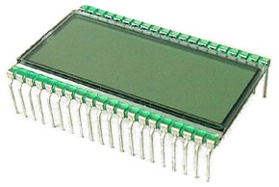
LCD
Segment LCD
Dot Matrix LCD
Notes:
{{Pause=3}} There are two major types of LCDs: segment LCD, and dot matrix LCD. A segment LCD can only display English alphabet, Arabic numbers and a few simple symbols. A dot matrix LCD has pixels arranged in rows and columns. Dot matrix LCDs are more flexible and can display more characters than segment LCDs. However, segment LCDs are cheaper. In this tutorial, we use segment LCDs as examples to illustrate how to develop software to control LCDs. The key ideas are also applicable to dot matrix LCD.

Slide 3
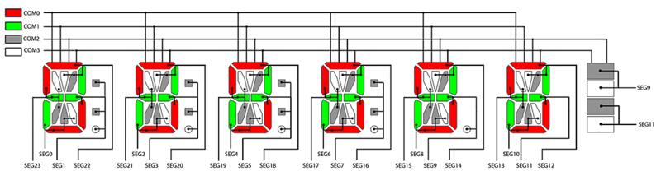
LCD module
Font Library
Display String
LCD Glass
LCD Display Memory
Hardware Signal
Generator
Position
Software Driver
Position: 1 2 3
multiplexed drive
Notes:
{{Pause=3}} An LCD module has four major components: LCD glass, {{Pause=2}} LCD hardware signal generator{{Pause=2}}, LCD display memory, {{Pause=2}} and software driver. The hardware signal generator uses a special hardware technology, called a multiplexed drive, to reduce the number of pins required to drive a LCD glass. Refer to the book for details.

Slide 4
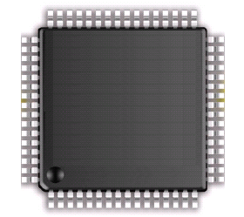
External controller vs On-chip LCD controller
+ Require less pins
+ Software simpler
External LCD controller
LCD Glass
LCD Display Memory
Hardware Signal
Generator
Serial
Communication
Interface
+ Smaller system, cheaper
- Require more pins, software more complex
On-chip LCD controller
LCD Glass
LCD Display Memory
Hardware Signal
Generator
Notes:
{{Pause=3}} The LCD controller can be built {{Pause=0.5}} in an external LCD module, or {{Pause=0.5}} in a microprocessor chip.
If the LCD controller is external to the processor, the processor uses some serial communication interface, to send a string to the controller.
If the LCD controller is on-chip, the microprocessor can directly drive an LCD glass, without any extra hardware. STM32L processors have on-chip LCD controller.
{{Pause=1}} An external LCD controller has two major advantages over an on-chip controller. First, an external controller typically requires much less processor pins. Second, software to interface an external LCD is relatively simpler.
{{Pause=1}} The advantage of having an on-chip LCD controller is that, the system can be made smaller and cheaper. However, it uses many processor pins, and requires complex software to drive the LCD.
In this tutorial, we focuses on the on-chip LCD controller.

Slide 5
Software Driver for On-chip LCD Controller
Font Library
Font = 0xFE00
“A”
LCD Glass
LCD Display Memory
Hardware Signal
Generator
Position = 1
Software Driver
Position: 1 2 3
Back buffer
(1st buffer)
Front buffer
(2nd buffer)
Hardware Signal
Generator
Software
Double buffering
Write to one buffer, display to another. Then when ready, swap (display first, write to second). Repeat.
Avoids tearing: displaying partially old and partially new data
Avoid flicker

Slide 6
Software Driver for On-chip LCD Controller
Font Library
Font = 0xFE00
“A”
LCD Glass
LCD Display Memory
Hardware Signal
Generator
Position = 1
Software Driver
1A = 1
1B = 1
1C = 1
1F = 1
1E = 1
1G = 1
1M = 1
Position: 1 2 3
Three tasks:
Define the fonts of alphanumeric
Convert ASCII to font
Decode font and modify the LCD display memory
Notes:
{{Pause=3}} Let’s focus on how to write software to drive the on-chip LCD controller on STM32L4 microprocessors. The software driver takes two inputs: first, an Alphanumeric character, and second, the target display position.
For example, we want to display the letter “A”, at the first position on the LCD. {{Pause=1}} On computers, the letter ‘A’ is represented by its ASCII value. Software looks up the font library based on the ASCII value, and finds the font of the letter “A”. Then, software modifies the LCD display memory, based on the font and the display position. Specifically, software will set the bits to 1 in the display memory that controls the on or off of the following segments: 1A, 1B, 1C, 1F, 1E, 1G, and 1M.
In summary, the LCD software driver has three tasks. Task 1, define the font for alphabet letters and Arabic numbers. Task 2, for a given character to be displayed, find its font by looking the font library defined in Task 1. Task 3, decode the font and modify the LCD display memory. The font library is only needed to be defined once. All characters share the same font library.

Slide 7
Task 1: Define Fonts
Each character has 16 segments (pixels)
1 bit to control ON/OFF of each segment
16 bits (or two bytes) for encoding each display character
Define the encoding order:
G, B, M, E, F, A, C, D, Q, K, COL, P, H, J, DP, N
15 14 13 12 11 10 9 8 7 6 5 4 3 2 1 0
Why this order?
No reasons. You can choose your own order.
Notes:
{{Pause=3}} On the STM32L4 discovery kit, the LCD glass can display, six characters. {{Pause=1}} Each character has 16 segments, such as segment A, segment B, segment C, and etc. {{Pause=2}} Suppose we use 1 bit to represent the ON or OFF setting of each segment, we need a total 16 bits to encode all segment of a character. {{Pause=2}} Let's assume that we encode the segment in this order: G, B, M, E, F, A, C, D, Q, K, and etc. {{Pause=2}} You may ask why we encode the binary ON or OFF information of these segments in this specific order. {{Pause=1}} In fact, you can use any order you want, as long as you use the same order when you decode the font.

Slide 8
Task 1: Define Fonts
Encoding Order = G, B, M, E, F, A, C, D, Q, K, COL, P, H, J, DP, N
15 14 13 12 11 10 9 8 7 6 5 4 3 2 1 0
Segments | G | B | M | E
Encoding
Segments | F | A | C | D
Encoding
Segments | Q | K | Colon | P
Encoding
Segments | H | J | DP | N
Encoding
Notes:
{{Pause=3}} Let’s use the letter “A” as an example, to show how to encode a letter, or a number. In order to display the letter “A”, we need to turn on the following 7 segments: A, B, C, F, E, G, and, M.

Slide 9
Task 1: Define Fonts
Encoding Order = G, B, M, E, F, A, C, D, Q, K, COL, P, H, J, DP, N
15 14 13 12 11 10 9 8 7 6 5 4 3 2 1 0
Segments | G | B | M | E
Encoding | 1 | 1 | 1 | 1
Segments | F | A | C | D
Encoding | 1 | 1 | 1 | 0
Segments | Q | K | Colon | P
Encoding | 0 | 0 | 0 | 0
Segments | H | J | DP | N
Encoding | 0 | 0 | 0 | 0
Notes:
{{Pause=1}} For each segment that needs to be turned on, we set the corresponding bit to 1. Otherwise, we clear the corresponding bit to 0. This table shows the ON or OFF setting of all 16 segments.

Slide 10
Task 1: Define Fonts
Encoding Order = G, B, M, E, F, A, C, D, Q, K, COL, P, H, J, DP, N
15 14 13 12 11 10 9 8 7 6 5 4 3 2 1 0
Segments | G | B | M | E
Encoding | 1 | 1 | 1 | 1 | 0xF
Segments | F | A | C | D
Encoding | 1 | 1 | 1 | 0 | 0xE
Segments | Q | K | Colon | P
Encoding | 0 | 0 | 0 | 0 | 0x0
Segments | H | J | DP | N
Encoding | 0 | 0 | 0 | 0 | 0x0
“A”
0xFE00
Notes:
{{Pause=1}} If we convert the 16-bit binary encoding to hex, we will obtain, F, E, zero, zero, in hex. Therefore, the letter “A” is encoded as, “F E zero zero”. We call this encoding as the font for letter “A”.

Slide 11
Task 1: Define Font Library
“A”
0xFE00
uint16_t Letters[26] = {
// A B C D E F G H I
0xFE00, 0x6714, 0x1D00, 0x4714, 0x9D00, 0x9C00, 0x3F00, 0xFA00, 0x0014,
// J K L M N O P Q R
0x5300, 0x9841, 0x1900, 0x5A48, 0x5A09, 0x5F00, 0xFC00, 0x5F01, 0xFC01,
// S T U V W X Y Z
0xAF00, 0x0414, 0x5B00, 0x18C0, 0x5A81, 0x00C9, 0x0058, 0x05C0
};
Notes:
{{Pause=3}} In the previous example, we encode the font of letter “A” as F E zero zero, in hex. Similarly, we can find the font for the remaining capital letters. We put the fonts into an array. We call this array as the font library.

Slide 12
Task 1: Define Fonts
uint16_t Numbers[10] = {
// 0 1 2 3 4
0x5F00, 0x4200, 0xF500, 0x6700, 0xEA00,
// 5 6 7 8 9
0xAF00, 0xBF00, 0x4600, 0xFF00, 0xEF00
};
? | * | - | %
0x6084 | 0xA0DD | 0x00C0 | 0xEC00, 0xB300
Notes:
{{Pause=3}} Similarly, we can also find the fonts for numbers, as well as a few special symbols that can be displayed on the 16-segment LCD, such as question mark, star, dash, and percentage sign.

Slide 13
Task 2: Convert ASCII to Font
// Find the font of a capital letter
// if c points to a capital letter
if ( (*c < 0x5B) && (*c > 0x40) ) {
// ASCII ‘A’ = 0x41, ‘Z’ = 0x5A
encoding = Letters[*c - 'A'];
}
// if c points to a lower-case letter,
// convert it to upper case
if ( (*c < 0x7B) && (*c > 0x60) ) {
// ASCII ‘a’ = 0x61, ‘z’ = 0x7A
encoding = Letters[*c - 'a'];
}
// Find font of a number
encoding = Numbers [*c – '0'];
// ASCII ‘0’ = 0x30
Notes:
{{Pause=3}} In the second task, we will explain, how to find the font of a letter or a number, by looking up the corresponding array. All strings are stored as an array of ASCII values in memory.
{{Pause=2}} For a capital letter, the index of its font in the array of Letters, is, the difference between, the ASCII values of this letter and letter “A”.
{{Pause=2}} For a lower case letters, we simply convert it to the capital case, and find the corresponding font.
{{Pause=2}} For a number, the index of its font in the array of Numbers, is, the difference between, the ASCII values of this number and number “0”.

Slide 14
LCD Driver Connection
28 Pins used:
24 segment lines (SEG0-SEG23)
4 common terminals
(COM0-COM3)
6 digits and 4 bars
96 pixel segments

Slide 15
Task 3: Modify Display Memory
Internal connection of LCD module
LCD Pin | COM3 | COM2 | COM1 | COM0 | LCD Pin
1 | 1N | 1P | 1D | 1E | SEG 0
2 | 1DP | 1COLON | 1C | 1M | SEG 1
3 | 2N | 2P | 2D | 2E | SEG 2
4 | 2DP | 2COLON | 2C | 2M | SEG 3
5 | 3N | 3P | 3D | 3E | SEG 4
6 | 3DP | 3COLON | 3C | 3M | SEG 5
7 | 4N | 4P | 4D | 4E | SEG 6
8 | 4DP | 4COLON | 4C | 4M | SEG 7
9 | 5N | 5P | 5D | 5E | SEG 8
10 | BAR2 | BAR3 | 5C | 5M | SEG 9
11 | 6N | 6P | 6D | 6E | SEG 10
12 | BAR0 | BAR1 | 6C | 6M | SEG 11
13 | COM3 |  |  |  | COM3
14 |  | COM2 |  |  | COM2
15 |  |  | COM1 |  | COM1
16 |  |  |  | COM0 | COM0
17 | 6J | 6K | 6A | 6B | SEG 12
18 | 6H | 6Q | 6F | 6G | SEG 13
19 | 5J | 5K | 5A | 5B | SEG 14
20 | 5H | 5Q | 5F | 5G | SEG 15
21 | 4J | 4K | 4A | 4B | SEG 16
22 | 4H | 4Q | 4F | 4G | SEG 17
23 | 3J | 3K | 3A | 3B | SEG 18
24 | 3H | 3Q | 3F | 3G | SEG 19
25 | 2J | 2K | 2A | 2B | SEG 20
26 | 2H | 2Q | 2F | 2G | SEG 21
27 | 1J | 1K | 1A | 1B | SEG 22
28 | 1H | 1Q | 1F | 1G | SEG 23
2nd display
position
Notes:
{{Pause=3}} In task 3, the software driver needs to modify the display memory. The first question we need to understand is that, to turn on a specific segment, which bit should be set to 1 in the display memory. Before we answer this question, let’s take a look at the LCD glass. The LCD glass has a total of 28 pins, including {{Pause=1}} 24 segment pins and {{Pause=1}} 4 com pins.
{{Pause=2}} This table shows how each segment is controlled by the LCDs pins. For example, Segment 2D, which means segment D at the 2nd display position, is controlled by, {{Pause=1}} LCD pin 3 and {{Pause=1}} LCD pin 15. LCD pin 3 is also called pin segment 2. {{Pause=1}} LCD Pin 15 is also called COM 1.

Slide 16
Connection between LCD Pins and Processor Pins
STM32L4 Pins | LCD Pin
PA7 (LCD_SEG4) | 1 (SEG 0)
PC5 (LCD_SEG23) | 2 (SEG 1)
PB1 (LCD_SEG6) | 3 (SEG 2)
PB13 (LCD_SEG13) | 4 (SEG 3)
PB15 (LCD_SEG15) | 5 (SEG 4)
PD9 (LCD_SEG29) | 6 (SEG 5)
PD11 (LCD_SEG31) | 7 (SEG 6)
PD13 (LCD_SEG33) | 8 (SEG 7)
PD15 (LCD_SEG35) | 9 (SEG 8)
PC7 (LCD_SEG25) | 10 (SEG 9)
PA15 (LCD_SEG17) | 11 (SEG 10)
PB4 (LCD_SEG8) | 12 (SEG 11)
PB9 (LCD_COM3) | 13 (COM 3)
PA10 (LCD_COM2) | 14 (COM 2)
PA9 (LCD_COM1) | 15 (COM 1)
PA8 (LCD_COM0) | 16 (COM 0)
PB5 (LCD_SEG9) | 17 (SEG 12)
PC8 (LCD_SEG26) | 18 (SEG 13)
PC6 (LCD_SEG24) | 19 (SEG 14)
PD14 (LCD_SEG34) | 20 (SEG 15)
PD12 (LCD_SEG32) | 21 (SEG 16)
PD10 (LCD_SEG30) | 22 (SEG 17)
PD8 (LCD_SEG28) | 23 (SEG 18)
PB14 (LCD_SEG14) | 24 (SEG 19)
PB12 (LCD_SEG12) | 25 (SEG 20)
PB0 (LCD_SEG5) | 26 (SEG 21)
PC4 (LCD_SEG22) | 27 (SEG 22)
PA6 (LCD_SEG3) | 28 (SEG 23)
?
49 pins can drive an LCD
28 LCD pins
System designers determine hardware connections:
Which pins are selected to drive the LCD?
What is their connection order?
Notes:
{{Pause=3}} The STM32L4 processor has 49 LCD pins, which have the alternate function of LCD. The LCD glass has only 28 pins. Therefore, when we design a circuit board, we need to think about which processor pins should be used to drive the LCD. The decision should be made carefully based on the overall needs of the whole systems, because a processor pin can only perform a limited number of pre-defined alternate functions. At the system design stage, we need to think about the overall pin assignment. For example, we need to consider: how many serial ports we need, how many I2C ports we need, how many GPIO pins we need, how many timer outputs or inputs we need, and etc.
{{Pause=1}} System designer determines, which processor pins are selected to connect the LCD, and what is the connection order between processor pins and LCD pins. Once the hardware connection is made, software cannot change it.
{{Pause=1}} On the STM32L4 discovery kit, the circuit designers have implemented the connections as shown in this table. {{Pause=1}} For example, the processor pin PA 7 is connected to the LCD pin 1. The processor pin PA 7 has the alternate function of LCD Segment 4.

Slide 17
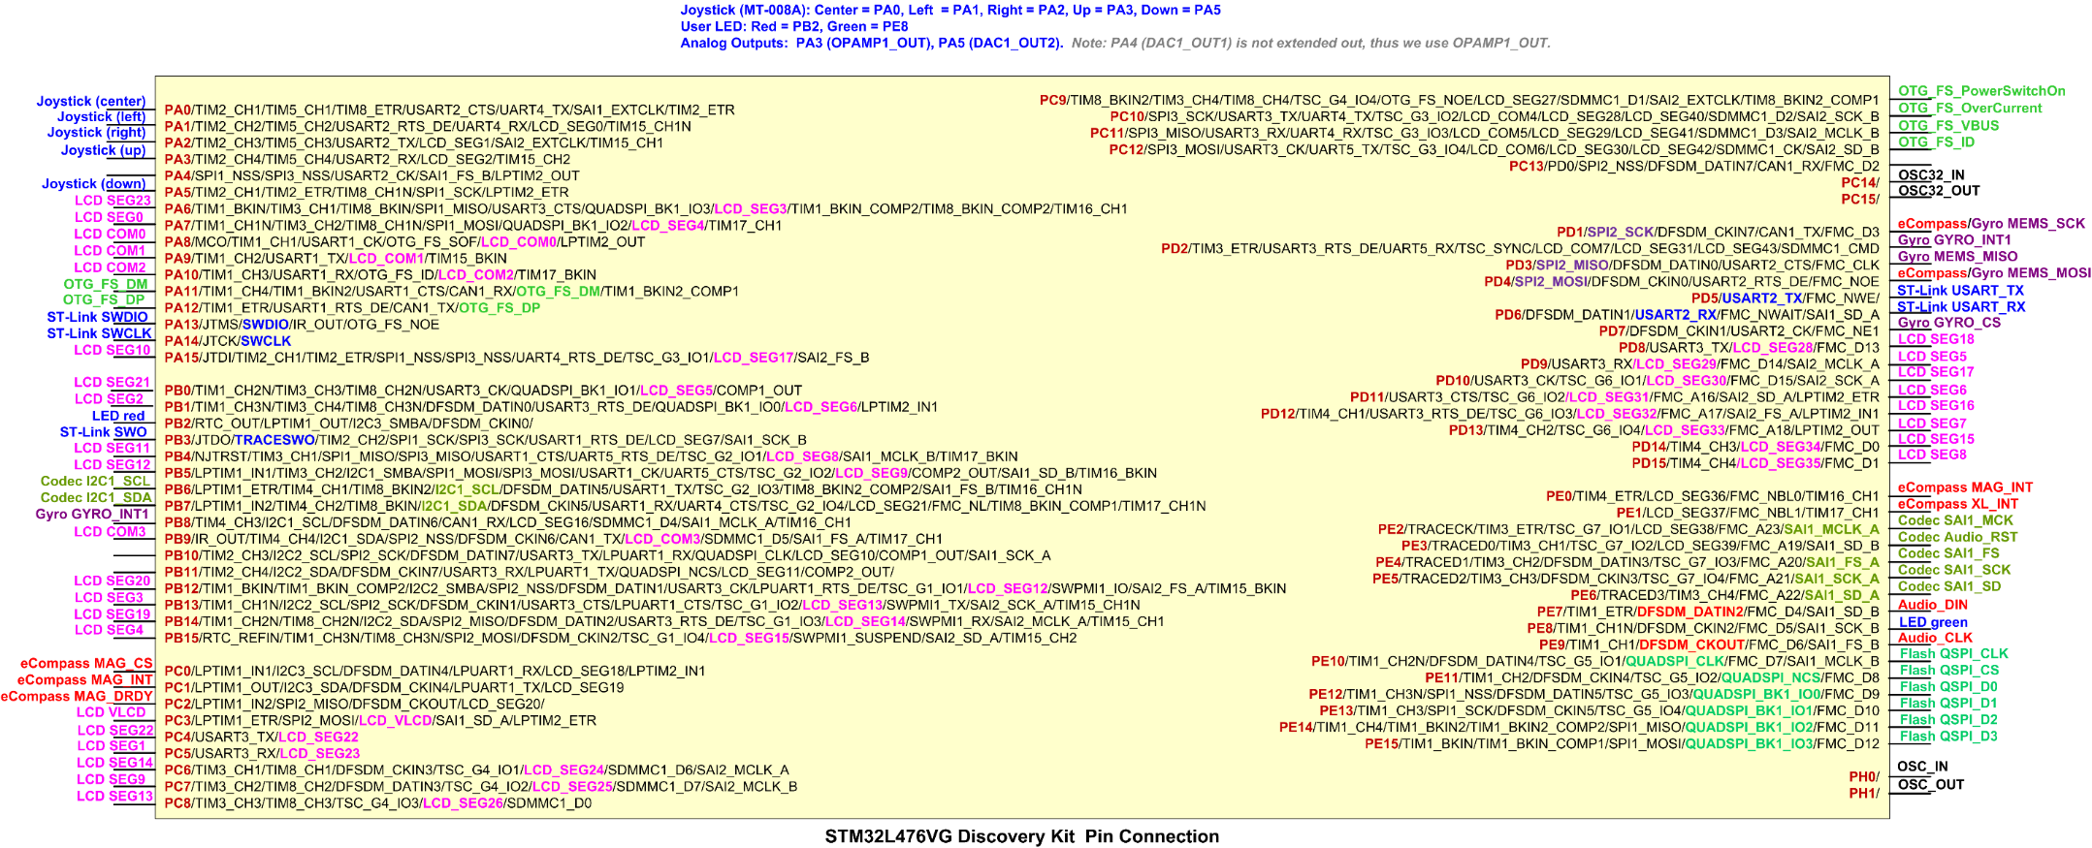
Processor’s Pins
49 pins can drive LCD: SEG 0 – SEG 43, or COM0 – COM7
You can download a higher resolution here:
http://web.eece.maine.edu/~zhu/book/STM32L4_Discovery_Kit_pins_L.png
Notes:
{{Pause=3}} Now, let’s take a look at the processor pins. The STM32L4 processor on the discovery kit has a total of 100 pins. Among these 100 pins, 49 pins are capable of driving an external LCD glass. {{Pause=0.5}} These pins can function from LCD Segment 0 to LCD Segment 43, or {{Pause=0.5}} from LCD COM 0 to LCD COM 7.

Slide 18
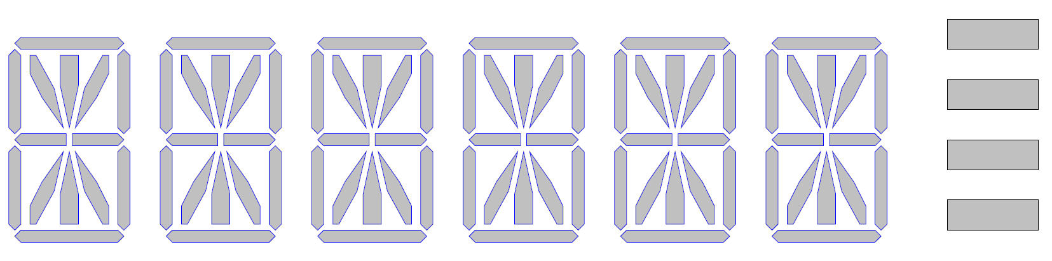
Mapping between Segments and Display Memory Bits
STM32L4 Pin | LCD Glass
 | LCD Pin | COM3 | COM2 | COM1 | COM0
PA7 (LCD_SEG4) | 1 (SEG 0) | 1N | 1P | 1D | 1E
PC5 (LCD_SEG23) | 2 (SEG 1) | 1DP | 1COLON | 1C | 1M
PB1 (LCD_SEG6) | 3 (SEG 2) | 2N | 2P | 2D | 2E
PB13 (LCD_SEG13) | 4 (SEG 3) | 2DP | 2COLON | 2C | 2M
PB15 (LCD_SEG15) | 5 (SEG 4) | 3N | 3P | 3D | 3E
PD9 (LCD_SEG29) | 6 (SEG 5) | 3DP | 3COLON | 3C | 3M
PD11 (LCD_SEG31) | 7 (SEG 6) | 4N | 4P | 4D | 4E
PD13 (LCD_SEG33) | 8 (SEG 7) | 4DP | 4COLON | 4C | 4M
PD15 (LCD_SEG35) | 9 (SEG 8) | 5N | 5P | 5D | 5E
PC7 (LCD_SEG25) | 10 (SEG 9) | BAR2 | BAR3 | 5C | 5M
PA15 (LCD_SEG17) | 11 (SEG 10) | 6N | 6P | 6D | 6E
PB4 (LCD_SEG8) | 12 (SEG 11) | BAR0 | BAR1 | 6C | 6M
PB9 (LCD_COM3) | 13 (COM 3) | COM3
PA10 (LCD_COM2) | 14 (COM 2) |  | COM2
PA9 (LCD_COM1) | 15 (COM 1) |  |  | COM1
PA8 (LCD_COM0) | 16 (COM 0) |  |  |  | COM0
PB5 (LCD_SEG9) | 17 (SEG 12) | 6J | 6K | 6A | 6B
PC8 (LCD_SEG26) | 18 (SEG 13) | 6H | 6Q | 6F | 6G
PC6 (LCD_SEG24) | 19 (SEG 14) | 5J | 5K | 5A | 5B
PD14 (LCD_SEG34) | 20 (SEG 15) | 5H | 5Q | 5F | 5G
PD12 (LCD_SEG32) | 21 (SEG 16) | 4J | 4K | 4A | 4B
PD10 (LCD_SEG30) | 22 (SEG 17) | 4H | 4Q | 4F | 4G
PD8 (LCD_SEG28) | 23 (SEG 18) | 3J | 3K | 3A | 3B
PB14 (LCD_SEG14) | 24 (SEG 19) | 3H | 3Q | 3F | 3G
PB12 (LCD_SEG12) | 25 (SEG 20) | 2J | 2K | 2A | 2B
PB0 (LCD_SEG5) | 26 (SEG 21) | 2H | 2Q | 2F | 2G
PC4 (LCD_SEG22) | 27 (SEG 22) | 1J | 1K | 1A | 1B
PA6 (LCD_SEG3) | 28 (SEG 23) | 1H | 1Q | 1F | 1G
1st
2nd
3rd
4th
5th
bars
6th
Segment 2D
Notes:
{{Pause=2}} This table presents put two pieces of information together. The first piece is the connection between the processor pins and the LCD glass pins. The second piece is the LCD’s internal relationship between LCD pins and LCD segments. {{Pause=1}} Let’s use LCD segment D on the second display position as example. We call this segment 2D. {{Pause=1}} Here is the segment 2D.

Slide 19
Mapping between Segments and Display Memory Bits
STM32L4 Pin | LCD Glass
 | LCD Pin | COM3 | COM2 | COM1 | COM0
PA7 (LCD_SEG4) | 1 (SEG 0) | 1N | 1P | 1D | 1E
PC5 (LCD_SEG23) | 2 (SEG 1) | 1DP | 1COLON | 1C | 1M
PB1 (LCD_SEG6) | 3 (SEG 2) | 2N | 2P | 2D | 2E
PB13 (LCD_SEG13) | 4 (SEG 3) | 2DP | 2COLON | 2C | 2M
PB15 (LCD_SEG15) | 5 (SEG 4) | 3N | 3P | 3D | 3E
PD9 (LCD_SEG29) | 6 (SEG 5) | 3DP | 3COLON | 3C | 3M
PD11 (LCD_SEG31) | 7 (SEG 6) | 4N | 4P | 4D | 4E
PD13 (LCD_SEG33) | 8 (SEG 7) | 4DP | 4COLON | 4C | 4M
PD15 (LCD_SEG35) | 9 (SEG 8) | 5N | 5P | 5D | 5E
PC7 (LCD_SEG25) | 10 (SEG 9) | BAR2 | BAR3 | 5C | 5M
PA15 (LCD_SEG17) | 11 (SEG 10) | 6N | 6P | 6D | 6E
PB4 (LCD_SEG8) | 12 (SEG 11) | BAR0 | BAR1 | 6C | 6M
PB9 (LCD_COM3) | 13 (COM 3) | COM3
PA10 (LCD_COM2) | 14 (COM 2) |  | COM2
PA9 (LCD_COM1) | 15 (COM 1) |  |  | COM1
PA8 (LCD_COM0) | 16 (COM 0) |  |  |  | COM0
PB5 (LCD_SEG9) | 17 (SEG 12) | 6J | 6K | 6A | 6B
PC8 (LCD_SEG26) | 18 (SEG 13) | 6H | 6Q | 6F | 6G
PC6 (LCD_SEG24) | 19 (SEG 14) | 5J | 5K | 5A | 5B
PD14 (LCD_SEG34) | 20 (SEG 15) | 5H | 5Q | 5F | 5G
PD12 (LCD_SEG32) | 21 (SEG 16) | 4J | 4K | 4A | 4B
PD10 (LCD_SEG30) | 22 (SEG 17) | 4H | 4Q | 4F | 4G
PD8 (LCD_SEG28) | 23 (SEG 18) | 3J | 3K | 3A | 3B
PB14 (LCD_SEG14) | 24 (SEG 19) | 3H | 3Q | 3F | 3G
PB12 (LCD_SEG12) | 25 (SEG 20) | 2J | 2K | 2A | 2B
PB0 (LCD_SEG5) | 26 (SEG 21) | 2H | 2Q | 2F | 2G
PC4 (LCD_SEG22) | 27 (SEG 22) | 1J | 1K | 1A | 1B
PA6 (LCD_SEG3) | 28 (SEG 23) | 1H | 1Q | 1F | 1G
LCD Segment: 2D
Pin 15
(COM1)
PA 9
(LCD_COM1)
Pin 3
(SEG 2)
PB 1
(LCD_SEG6)
Segment 2D is controlled by the bit for SEG 6 of COM 1 in the display memory.
Notes:
{{Pause=2}}This table shows that, in the LCD internal circuit, segment 2D is driven by two LCD pins: {{Pause=1}} LCD Pin 3, and {{Pause=1}} LCD pin 15.
{{Pause=2}} The table also shows that LCD’s pin 3 is connected to the processor’s pin P B 1, {{Pause=1}} and LCD’s pin 15 is connected to the processor’s pin P A 9.
{{Pause=1}} This figure shows the connection diagram. Pin 3 connected to P A 9. Pin 15 connected to P B 1.
{{Pause=1}} If we look at the reference manual of STM32L4 processors, we can find that, the LCD alternate function of the processor’s pin P B 1, is Segment 6. {{Pause=1}} and the LCD alternate function of the processor’s pin P A 9, is COM 1.
{{Pause=1}} Therefore, we conclude that, LCD segment 2D is controlled by the bit for, Segment 6 of COM 1, in the display memory.

Slide 20
Mapping Between Display Memory Bits and Processor Pins
Segment 2D is mapped to the bit for SEG 6 of COM 1 in the display memory.
→ Segment 2D is controlled by bit 6 of LCD_RAM[2].
Notes:
{{Pause=3}} In the previous slide, we have found that LCD segment 2D is controlled by the bit for Segment 6 of COM 1 in the display memory. Now, let’s take a look at the display memory again. We can locate the bit in the display memory. This display memory table is given in the STM32L4 reference manual. {{Pause=1}} Here, we locate the bit for Segment 6 of COM 1, which is bit 6 of LCD RAM 2. {{Pause=1}} Therefore, LCD segment 2D is controlled by bit 6 of LCD RAM 2.

Slide 21
Mapping Between Display Memory Bits and Processor Pins
Notes:
{{Pause=3}} In the previous slide, we locate the bit in the display memory, which controls LCD segment 2D. Following the same procedure, we can find all bits in the processor’s display memory, which control all segments of the LCD. {{Pause=2}} Next, we will show you an example, how to write software program, to show letter “A”, at the first position on the LCD.

Slide 22
Mapping Between Display Memory Bits and Processor Pins
LCD->RAM[0] &= ~( 1U << 3 | 1U << 4 | 1U << 22 | 1U << 23 );
LCD->RAM[2] &= ~( 1U << 3 | 1U << 4 | 1U << 22 | 1U << 23 );
LCD->RAM[4] &= ~( 1U << 3 | 1U << 4 | 1U << 22 | 1U << 23 );
LCD->RAM[6] &= ~( 1U << 3 | 1U << 4 | 1U << 22 | 1U << 23 );
LCD->RAM[0] |= 1U << 3 | 1U << 4 | 1U << 22 | 1U << 23;
LCD->RAM[2] |= 1U << 3 | 1U << 22 | 1U << 23;
Notes:
{{Pause=3}} In this table, we mark all bits that controls the segments of the first display position in color. {{Pause=2}} To show letter, “A”, at the first position on the LCD, we need to turn on the following 7 segments, including segment 1A, {{Pause=0.5}} 1B, {{Pause=0.5}} 1C, {{Pause=0.5}} 1F, {{Pause=0.5}} 1E, {{Pause=0.5}} 1G, {{Pause=0.5}} and, 1M, {{Pause=0.5}} and turn off all remaining segments of the first display position. Therefore, we need to set all bits marked in red to 1, and {{Pause=1}} reset all bits marked in blue to zero. {{Pause=1}} Here is the software code. First, the code clears all bits that belongs to the first display position. Then, software sets all bits marked in red in the display memory, including 1G, {{Pause=0.5}} 1E, {{Pause=0.5}} 1B, {{Pause=0.5}} 1M, {{Pause=0.5}} 1F, {{Pause=0.5}} 1A, {{Pause=0.5}} and 1C.

Slide 23
LCD Driver
Get the font and modify the display memory:
Suppose the font is stored in the array C[4].
The following example controls the display at the first position based on the font.
// Clear corresponding bits in the buffer LCD->RAM // 1G -> Bit 4, 1B -> Bit 23, 1M -> Bit 22, 1E -> Bit 3 in RAM[0] LCD->RAM[0] &= ~( 1U << 4 | 1U << 23 | 1U << 22 | 1U << 3 ); // 1F -> Bit 4, 1A -> Bit 23, 1C -> Bit 22, 1D -> Bit 3 in RAM[2] LCD->RAM[2] &= ~( 1U << 4 | 1U << 23 | 1U << 22 | 1U << 3 ); // 1Q -> Bit 4, 1K -> Bit 23, 1Col -> Bit 22, 1P -> Bit 3 in RAM[4] LCD->RAM[4] &= ~( 1U << 4 | 1U << 23 | 1U << 22 | 1U << 3 ); // 1H -> Bit 4, 1J -> Bit 23, 1DP -> Bit 22, 1N -> Bit 3 in RAM[6] LCD->RAM[6] &= ~( 1U << 4 | 1U << 23 | 1U << 22 | 1U << 3 ); // Segments: 1G 1B 1M 1E LCD->RAM[0] |= ((C[0] & 0x1) << 4) | (((C[0] & 0x2) >> 1) << 23) | (((C[0] & 0x4) >> 2) << 22) | (((C[0] & 0x8) >> 3) << 3); // Segments: 1F 1A 1C 1D LCD->RAM[2] |= ((C[1] & 0x1) << 4) | (((C[1] & 0x2) >> 1) << 23) | (((C[1] & 0x4) >> 2) << 22) | (((C[1] & 0x8) >> 3) << 3); // Segments: 1Q 1K 1Col 1P LCD->RAM[4] |= ((C[2] & 0x1) << 4) | (((C[2] & 0x2) >> 1) << 23) | (((C[2] & 0x4) >> 2) << 22) | (((C[2] & 0x8) >> 3) << 3); // Segments: 1H 1J 1DP 1N LCD->RAM[6] |= ((C[3] & 0x1) << 4) | (((C[3] & 0x2) >> 1) << 23) | (((C[3] & 0x4) >> 2) << 22) | (((C[3] & 0x8) >> 3) << 3);
Repeat for the other positions
Notes:
{{Pause=3}} Here is the key idea of LCD driver. Suppose, the font is stored in the array, C 4. This example controls the display at the first position based on the font. For a given font, we turn on, or turn off each LCD segment, based on the encoded on or off information, in the font. Please read the book for details.

Slide 24
Debug Trick
STM32L4 Pin | LCD Glass
 | LCD Pin | COM3 | COM2 | COM1 | COM0
PA7 (LCD_SEG4) | 1 (SEG 0) | 1N | 1P | 1D | 1E
PC5 (LCD_SEG23) | 2 (SEG 1) | 1DP | 1COLON | 1C | 1M
PB1 (LCD_SEG6) | 3 (SEG 2) | 2N | 2P | 2D | 2E
PB13 (LCD_SEG13) | 4 (SEG 3) | 2DP | 2COLON | 2C | 2M
PB15 (LCD_SEG15) | 5 (SEG 4) | 3N | 3P | 3D | 3E
PD9 (LCD_SEG29) | 6 (SEG 5) | 3DP | 3COLON | 3C | 3M
PD11 (LCD_SEG31) | 7 (SEG 6) | 4N | 4P | 4D | 4E
PD13 (LCD_SEG33) | 8 (SEG 7) | 4DP | 4COLON | 4C | 4M
PD15 (LCD_SEG35) | 9 (SEG 8) | 5N | 5P | 5D | 5E
PC7 (LCD_SEG25) | 10 (SEG 9) | BAR2 | BAR3 | 5C | 5M
PA15 (LCD_SEG17) | 11 (SEG 10) | 6N | 6P | 6D | 6E
PB4 (LCD_SEG8) | 12 (SEG 11) | BAR0 | BAR1 | 6C | 6M
PB9 (LCD_COM3) | 13 (COM 3) | COM3
PA10 (LCD_COM2) | 14 (COM 2) |  | COM2
PA9 (LCD_COM1) | 15 (COM 1) |  |  | COM1
PA8 (LCD_COM0) | 16 (COM 0) |  |  |  | COM0
PB5 (LCD_SEG9) | 17 (SEG 12) | 6J | 6K | 6A | 6B
PC8 (LCD_SEG26) | 18 (SEG 13) | 6H | 6Q | 6F | 6G
PC6 (LCD_SEG24) | 19 (SEG 14) | 5J | 5K | 5A | 5B
PD14 (LCD_SEG34) | 20 (SEG 15) | 5H | 5Q | 5F | 5G
PD12 (LCD_SEG32) | 21 (SEG 16) | 4J | 4K | 4A | 4B
PD10 (LCD_SEG30) | 22 (SEG 17) | 4H | 4Q | 4F | 4G
PD8 (LCD_SEG28) | 23 (SEG 18) | 3J | 3K | 3A | 3B
PB14 (LCD_SEG14) | 24 (SEG 19) | 3H | 3Q | 3F | 3G
PB12 (LCD_SEG12) | 25 (SEG 20) | 2J | 2K | 2A | 2B
PB0 (LCD_SEG5) | 26 (SEG 21) | 2H | 2Q | 2F | 2G
PC4 (LCD_SEG22) | 27 (SEG 22) | 1J | 1K | 1A | 1B
PA6 (LCD_SEG3) | 28 (SEG 23) | 1H | 1Q | 1F | 1G
Suppose segment 1F cannot be turned on
Segment 1F is controlled by PA6 (LCD_SEG3) and PA9 (LCD_COM1)
Check pin PA6 and PA9:
AF mode,
LCD AF function
Check the bit in the display memory, mapping to SEG 3 and COM1, i.e., bit 3 of LCD_RAM[2]
Notes:
{{Pause=3}} Now, let me show you one debug trick. Suppose we want to display, letter “A”, at the first display position. However, segment 1F is off by mistake. {{Pause=1}} How to quickly find the problem?
{{Pause=2}} Let’s take a look at the connection table. We locate segment 1F in the table first. {{Pause=1}} Here is Segment 1F. {{Pause=1}} The table shows that, segment 1F, is controlled by processor’s pin, P A 6, and {{Pause=0.5}} P A 9. Therefore, the first to check the GPIO pin initialization has been performed correctly. Specially, we need to make sure that the mode of pin PA 6 and PA 9 have been set to alternate function, and their alternate function has been set to LCD. {{Pause=1}} Next, we need to check the display memory. We need to check whether bit 3 of LCD RAM 2 has been set to 1. We can check this bit in the Keil debug IDE.

Slide 25
Too Many Pins Required
Six digits and four bars
Each digit has 16 segments: 14 digital segments, 1 colon, 1 point
Thus:
6 x 6 + 4 = 100 display segments
If all display segments share the same ground, and each display segment needs a pin to drive, then we need a total 100 pins.
But we only have 28 pins.
How can we control 100 segments using just 28 pins?

Slide 26
Multiplexed Drive
Font Library
Display String
LCD Glass
LCD Display Memory
Hardware Signal
Generator
Position
Software Driver
Position: 1 2 3
multiplexed drive
from https://habrahabr.ru/post/173709/
Notes:
{{Pause=3}} An LCD module has four major components: LCD glass, {{Pause=2}} LCD hardware signal generator{{Pause=2}}, LCD display memory, {{Pause=2}} and software driver. The hardware signal generator uses a special hardware technology, called a multiplexed drive, to reduce the number of pins required to drive a LCD glass. Refer to the book for details.

Slide 27
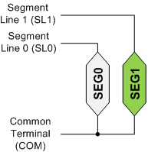

Static Driving Method (Duty = 1)
When the segment voltage across is greater than a threshold voltage, this segment becomes visible.
The segment voltage must be alternated to avoid damage.
Each segment is driven with two square waveforms.
Good display quality

Slide 28

Static Driving Method (Duty = 1)
When the segment voltage across is greater than a threshold voltage, this segment becomes visible.
The segment voltage must be alternated to avoid damage.
Each segment is driven with two square waveforms.
Good display quality
Segment 0 is turned off
Segment 1 is turned on
Notes:
Applying DC voltage for too long can damage, so circuit must provide an AC voltage centered on zero.

Slide 29
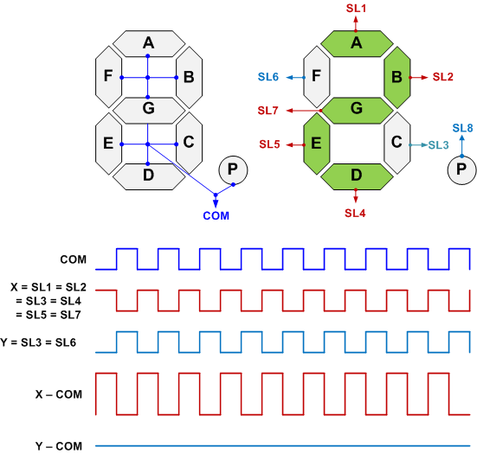
7 Segment
Eight connections:
7 segment lines
1 common terminal
Two square waves to drive these connections

Slide 30
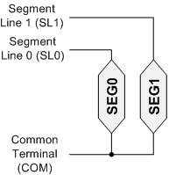
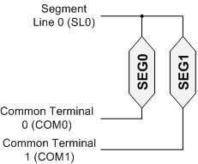
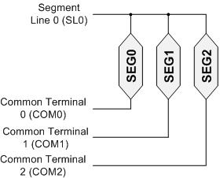


Duty Ratio
Duty Ratio
how long each segment is activated during each frame
Duty = 1
Duty = 1/2
Duty = 1/3
$$Duty Ratio=\frac{1}{Segments Driven by Each Line}$$
i.e.
$$Duty Ratio=\frac{1}{Number of Common Terminals}$$

Slide 31
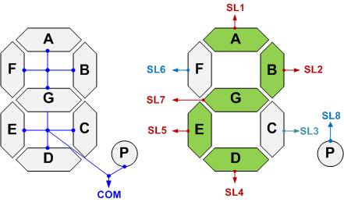
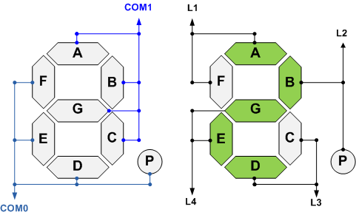
Duty 1 vs Duty ½
Duty = 1
Duty = 1/2
Require 9 pins
Require only 6 pins
Reduce the number of pins!

Slide 32
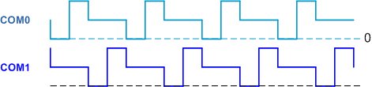
Duty Ratio = 1/2

Slide 33


Duty Ratio = 1/2
Drive Bias
the number of voltage levels used
$$Bias= \frac{1}{Number of Voltage Levels −1}$$
$$Bias= \frac{1}{2}$$

Slide 34
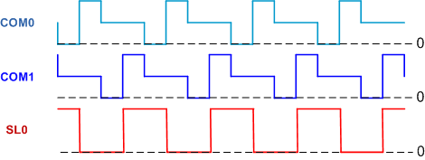
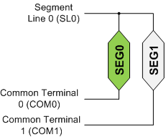
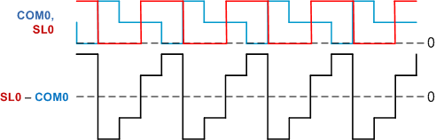
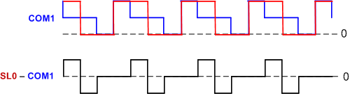
Duty Ratio = ½, SEG0 ON, SEG1 OFF
Voltage across SEG0
Voltage across SEG1

Slide 35
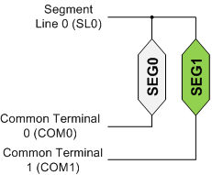
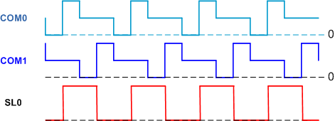
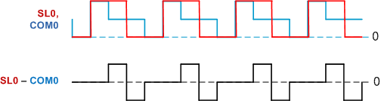
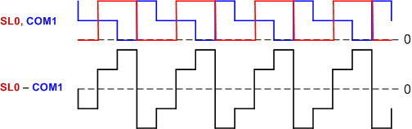
Duty Ratio = ½, SEG0 OFF, SEG1 ON
Voltage across SEG0
Voltage across SEG1

Slide 36
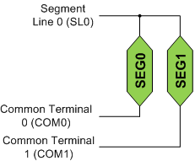
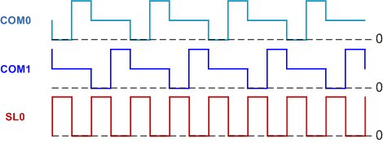
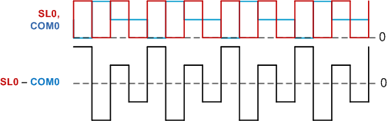
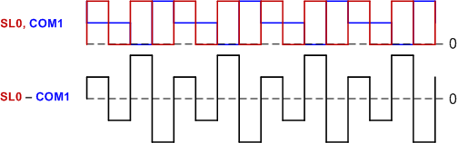
Duty Ratio = ½, BOTH ON
Voltage across SEG0
Voltage across SEG1

Slide 37
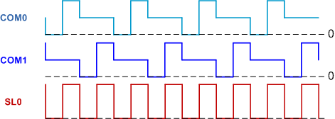
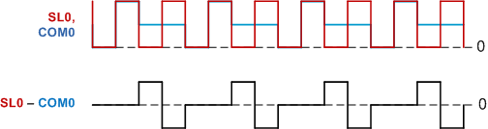
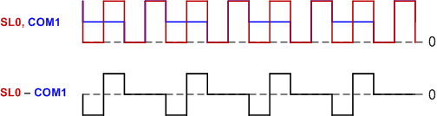
Duty Ratio = ½, BOTH OFF
Voltage across SEG0
Voltage across SEG1

Slide 38
7 Segment Display
Two com terminals
Duty Cycle = 1/2

Slide 39
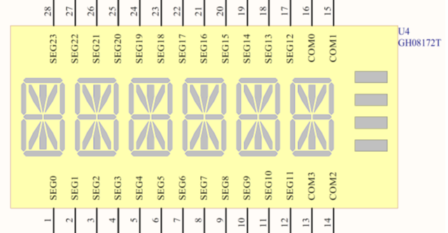
STM32L1/STM32L4 Discovery Kit LCD Module
Four com terminals
Duty Cycle = 1/4

Slide 40
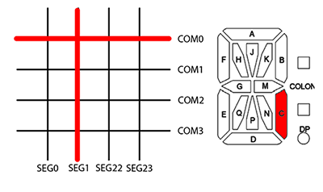
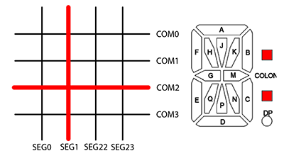
STM32L1/STM32L4 Discovery Kit LCD Module
from https://habrahabr.ru/post/173709/

Slide 41
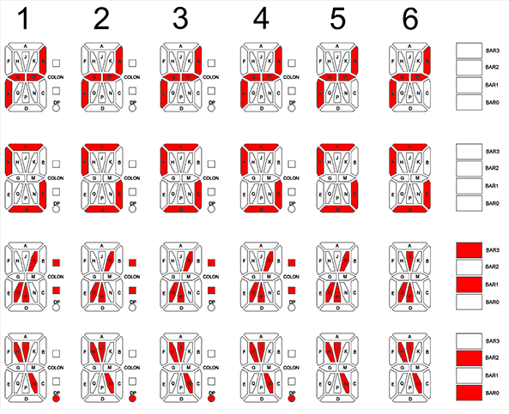
STM32L1/STM32L4 Discovery Kit LCD Module
COM0
COM1
COM2
COM3
from https://habrahabr.ru/post/173709/

Slide 42
Lab Tips
Most implementation is given in file LCD.c in the project template.
Alternate function of each pin:
http://web.eece.maine.edu/~zhu/book/STM32L4/STM32L476_Pins.pdf
When you program Port A and mistakenly change the mode or the alternate function number for pin PA 13 and PA 14, Keil can no longer program your board.
These two pins are used as ST-Link SW_IO and SW_CLK for the communication with the debugger
Fix: Use ST-Link Utility to erase the code

